Slide 1





Natural Language Processing with Disaster Tweets
Sai Kumar Reddy Nossam - snossam@kent.edu
Vineeth Billa Kanti - vbillaka@kent.edu
Likitha Guthikonda - lguthiko@kent.edu
Abhinay Reddy Guntipally - aguntipa@kent.edu

Slide 2


INDEX
NLP
Problem Statement
Customers &
End Users
Data Set Description
Methodology
Data Cleaning
EDA
Results & Analysis
Assumptions & Risks
Future Work
Acknowledgements

Slide 3
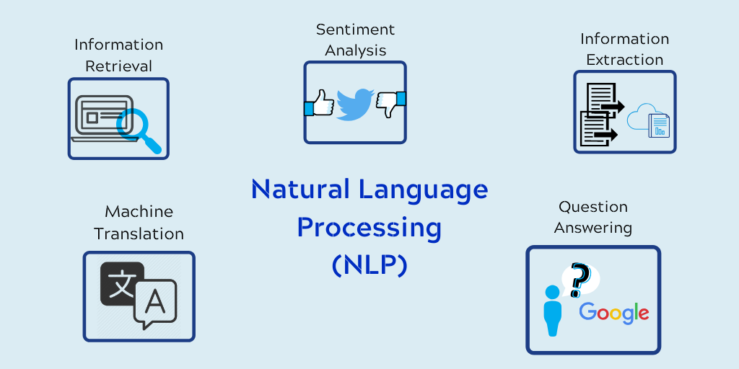
NLP
Problem Statement
The branch of artificial intelligence known as natural language processing, or NLP, allows computers to read, comprehend, and interpret human languages.
Every day, we make use of NLP, such as autocorrect when we're unsure how to spell a word.
Due to the unpredictable and dangerous nature of natural disasters, it is critical to gather relevant information and data about disasters as soon as possible; this helps humanitarian groups prioritize their work.
The purpose of this project is to develop a machine learning model that can determine which Tweets are about actual disasters and which ones are not.
We have access to a dataset of 10,000 tweets that were manually categorized.

Slide 4
End Users and Customers
Identifying Customers
A customer is the purchaser of a product or service. This individual may or may not be an end user.
Typically, the first responders to disasters such as natural disasters are police, firemen, paramedics, or emergency medical technicians (EMT), disaster relief organizations, and news agencies.
The primary duty of first responders is to guarantee the safety of individuals. All these government agencies can be considered customers, as well as any private organizations who would like to aid during natural disasters.
Identifying End-Users
An end user is a consumer of the product or service. This person may or may not be a customer. It might be a member of the organization or a person with whom the customer wants to do business.
So, our end users can be common people, and the employees in disaster relief organizations, and news agencies.

Slide 5
Data set Description
We are predicting whether a given tweet is about a real disaster or not.
We have 7613 rows and 5 columns in train data set and 3243 rows ,4 columns in test data set.
The sample data has only id and target
Each sample in the train and test set has the following information:
1. The text of a tweet.
2. A keyword from the tweet. (although this maybe blank!)
3. The location the tweet was sent from (may also be blank)
Columns:
Id – A unique identifier for each tweet.
Text – the text of the tweet.
Location – The location the tweet was sent
from (may be blank)
Keyword – a particular keyword from the
tweet (may be blank)
Target – in train.csv only, this denotes
whether a tweet is about a real disaster (1)
or not (0).

Slide 6
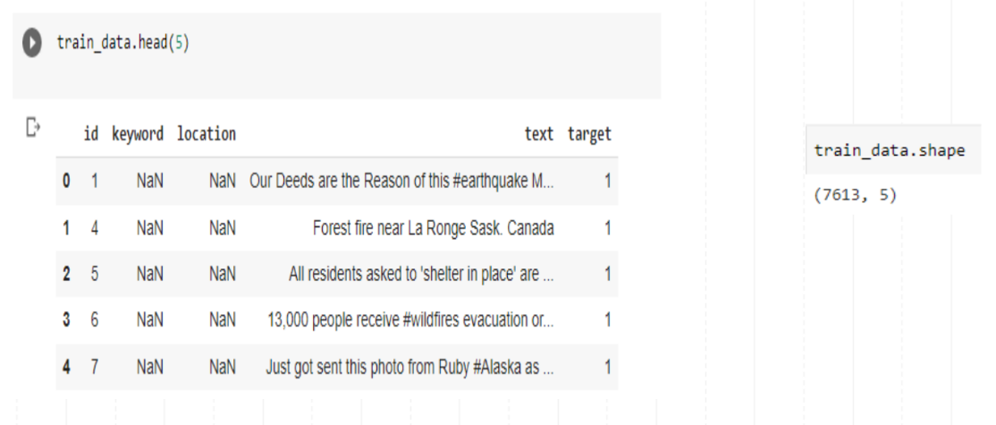
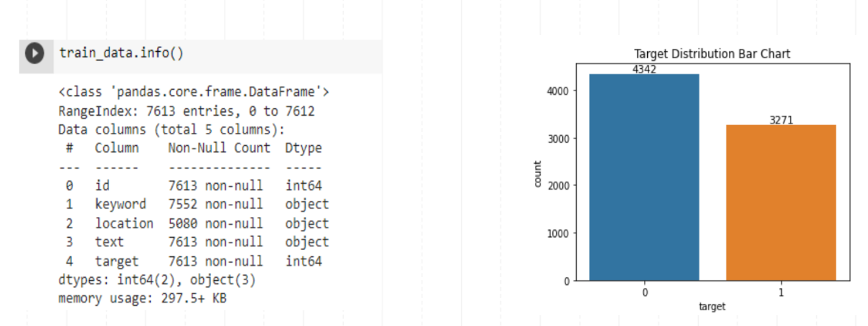
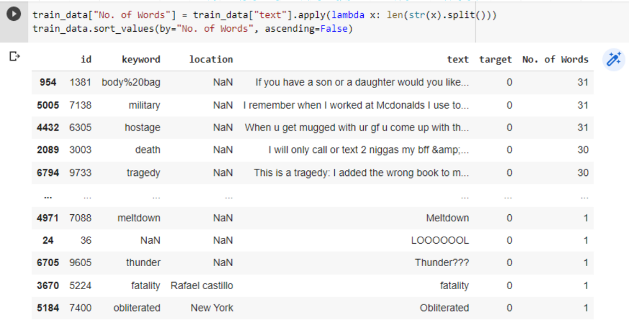
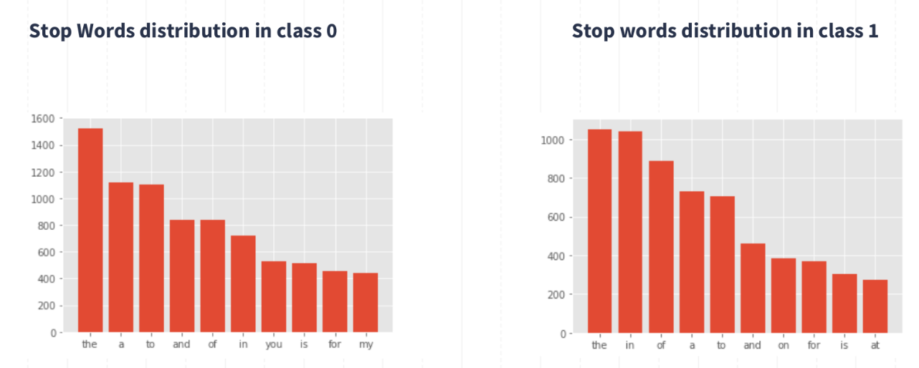
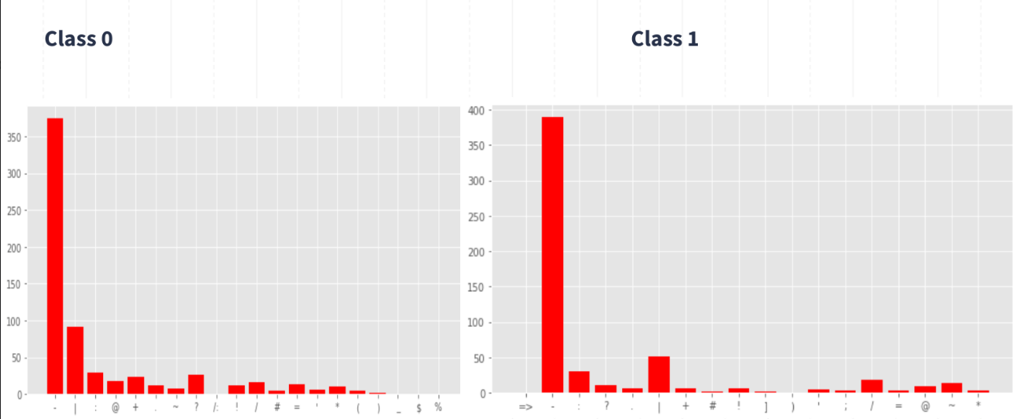
Exploratory Data Analysis (EDA)
Rows and Columns
Target Class Distribution
Number of words in each tweet
Stop words
Analyzing Punctuations

Slide 7
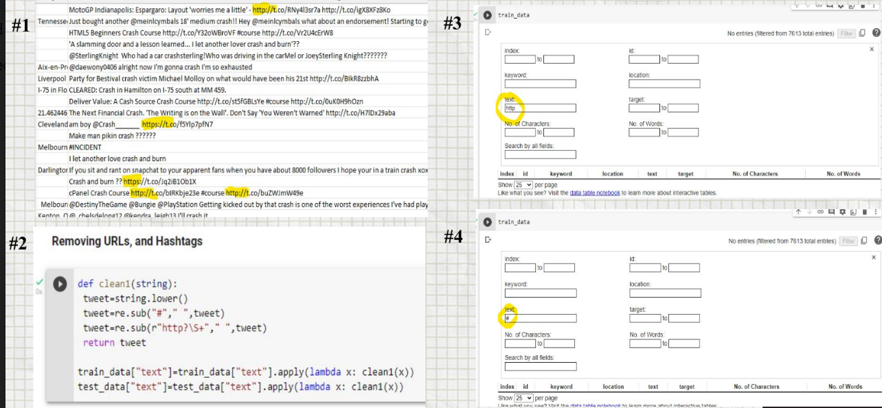

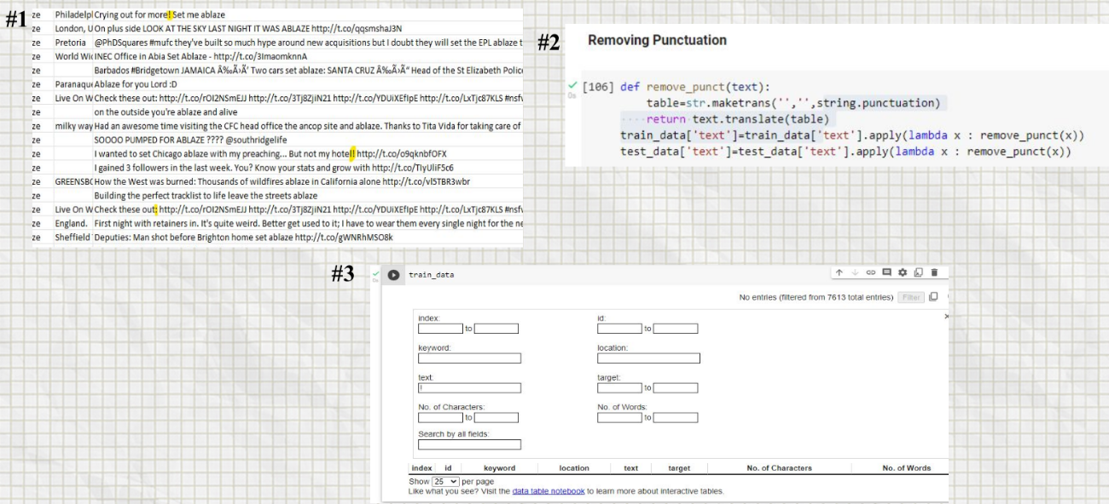
Data Cleaning
Tweets need a lot of cleaning but cleaning every single tweet would be inefficient ,because it would take too long. Cleaning requires the implementation of a general strategy:
Removing Special Characters
Removing Urls
Removing Punctuations
Spelling Correction
Removing Emails
Removing Accented Characters

Slide 8
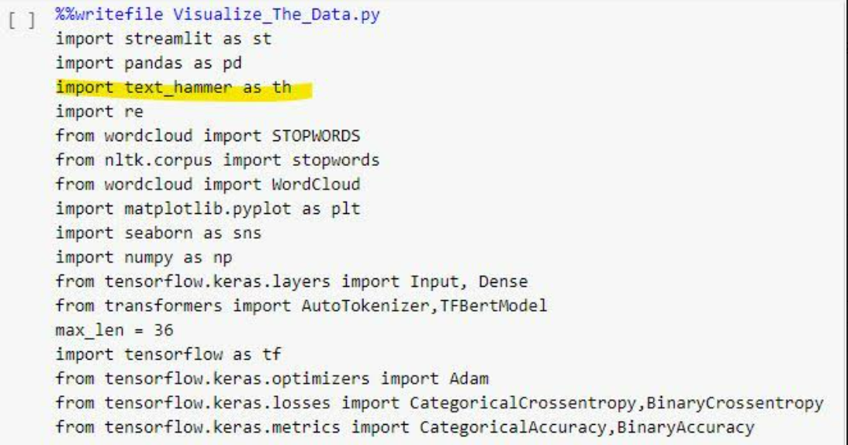
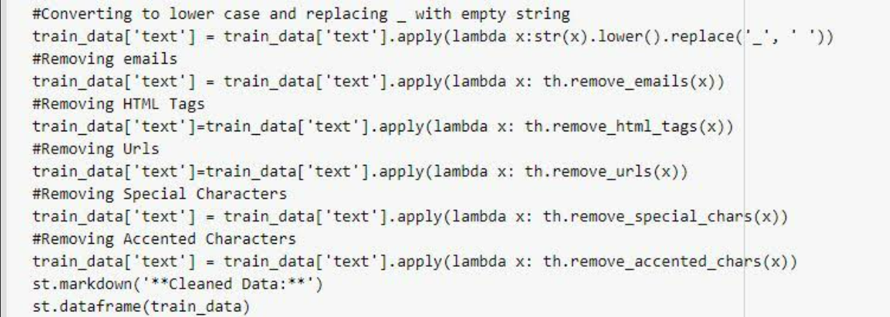
Text Hammer
It is a text Pre-processing Package

Slide 9
Methodology
In 2019, Google announced that it has started using BERT in its search engine, and by late 2020, it was employing BERT in almost all English-language queries.
How does BERT work?
Language modeling (15% of tokens were masked, and BERT was taught to interpret them from context) and next sentence prediction were the two tasks that BERT had been pretrained on (BERT was trained to predict if a chosen next sentence was probable or not given the first sentence).
BERT was trained on two modelling methods:
Masked Language Model
Next Sentence Prediction
BERT gains knowledge of word contextual embeddings as a result of training

Slide 10
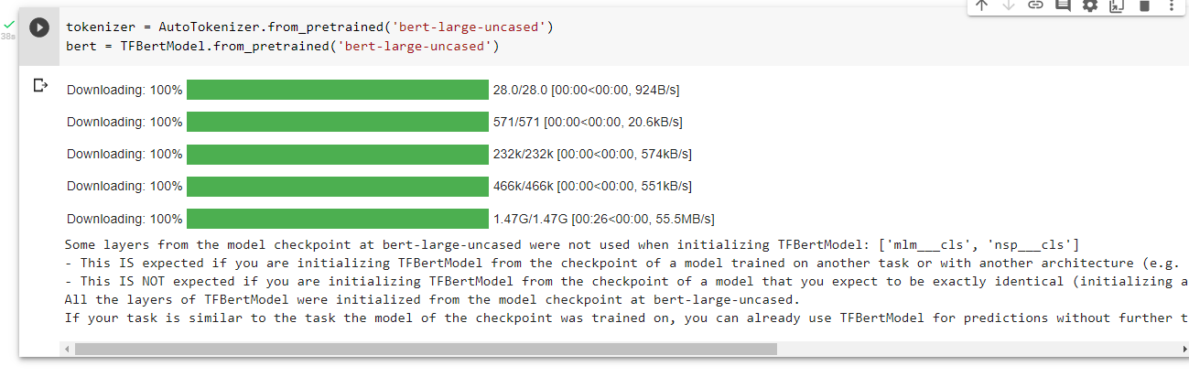
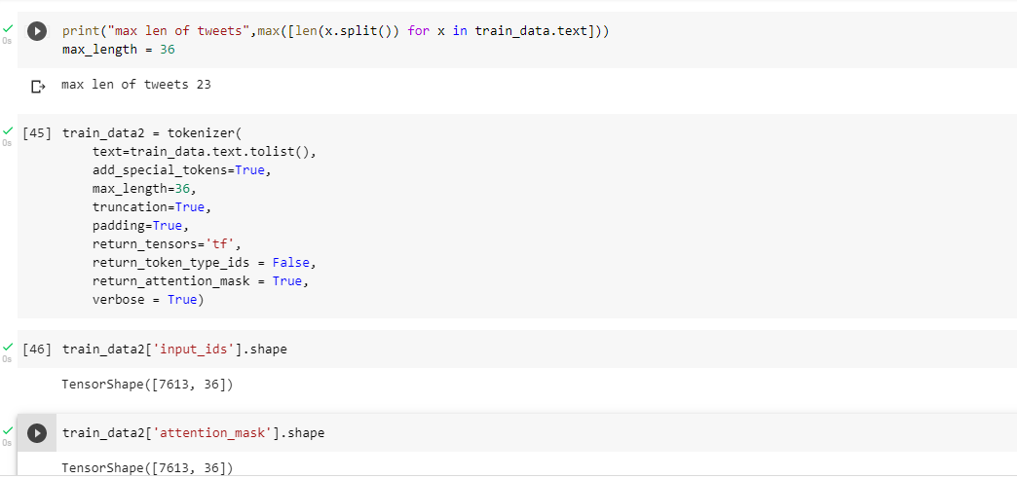
BERT’s Functionality
Loading BERT Model
Converting of text data into BERT input Format

Slide 11
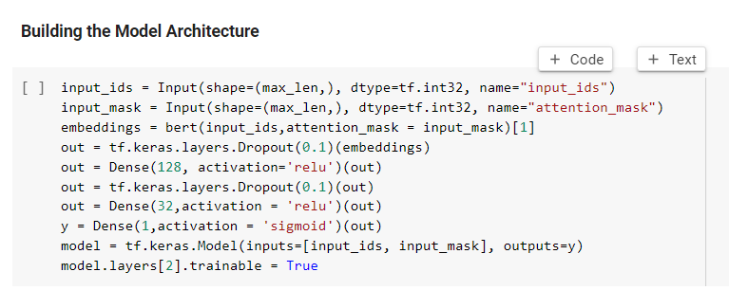
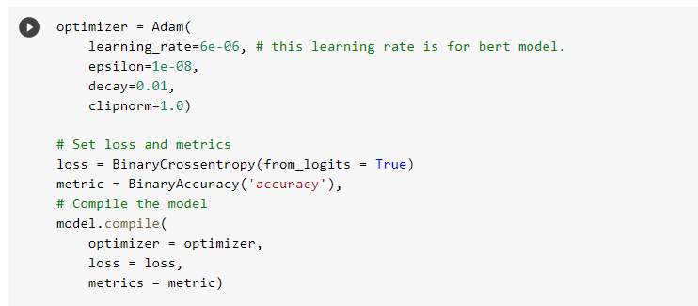
BERT’s Functionality
Building the Model Architecture
Using the Adam optimizer

Slide 12
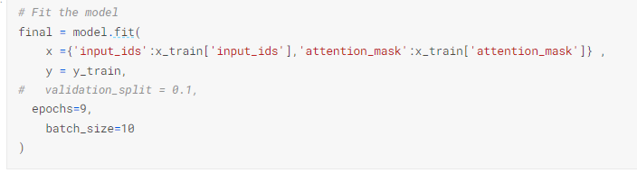
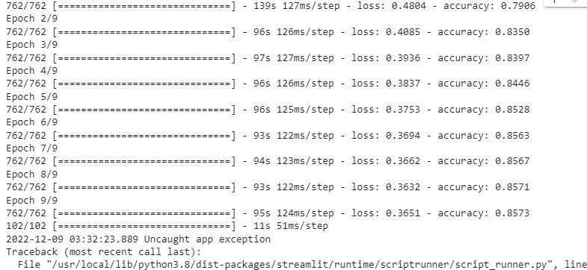
BERT’s Functionality
Fitting the Model
Accuracy

Slide 13
Streamlit
Streamlit is an open-source app framework in Python language.
It helps us create web apps for data science and machine learning in a short time.
It is compatible with major Python libraries such as scikit-learn, Keras, PyTorch, SymPy(latex), NumPy, pandas, Matplotlib etc.
Streamlit allows us to write an app the same way you write a python code.

Slide 14
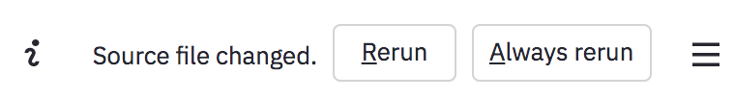
Streamlit – Development Flow
If the source code of the streamlit’s python script changes the app shows whether to rerun the application or not in the top-right corner. We can also select the ‘Always rerun’ option to rerun always when the source script changes.
This makes our development flow much easier, every time we make some changes it’ll reflect immediately in our web app. This loop between coding and viewing results live makes our work seamlessly with streamlit.

Slide 15
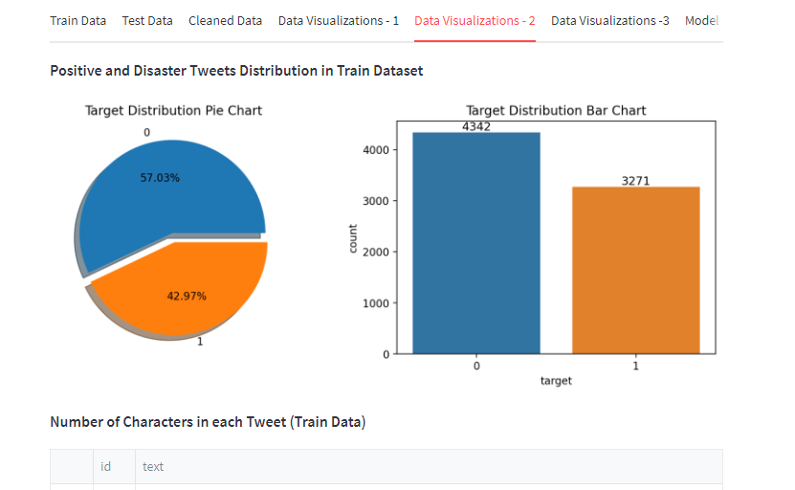
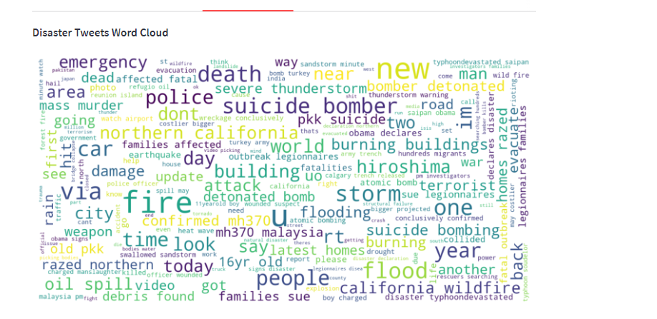
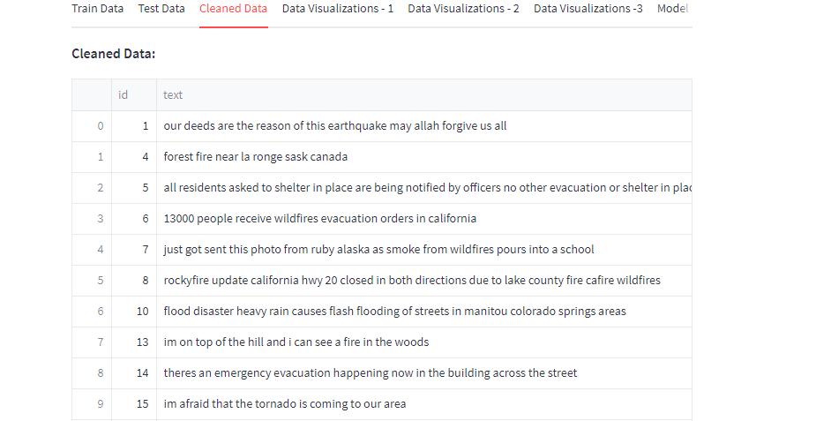
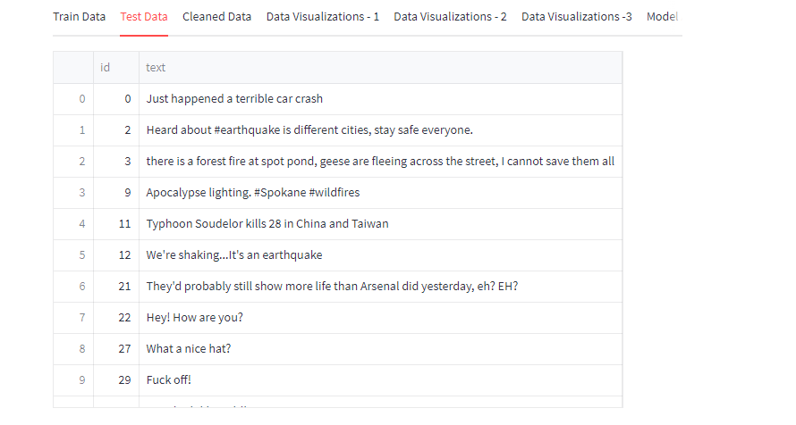

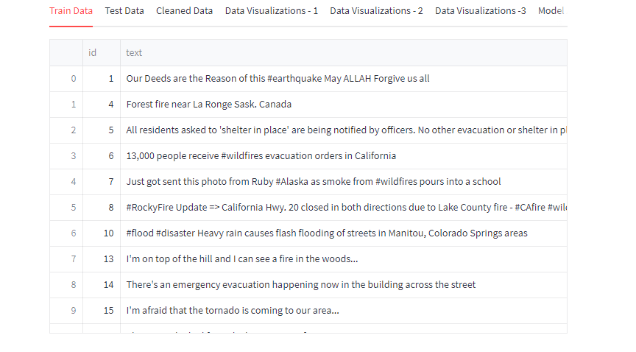
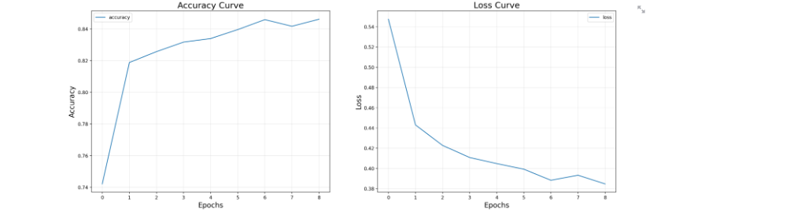
Our Web Application using Streamlit

Slide 16
Constraints Imposed by the Customer & Assumptions and Risks
Noise and Outliers are components of the dataset that must be handled with exceptional care to increase the accuracy of the model.
There is no need for sub-second latency. However, the execution of training or inference should not take too long.
A naive assumption regarding new occurrences is that those including the keywords "outbreak" and "wreckage" are likely to be about disasters. But those containing "Armageddon" and "body" are likely to be about non-disasters.
There are many other aspects to consider. For example, if someone was during a natural disaster, would they write longer or shorter tweets, would they use punctuation?
Constraints Imposed
Assumptions & Risks

Slide 17
Future Work
Improving the performance
We can get more models better than BERT
We can develop mobile application

Slide 18
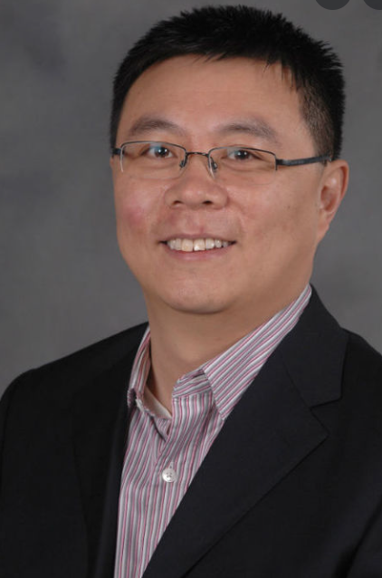

Acknowledgements
Thanks to Prof. Dr. Ruoming Jin, who kindly agreed to serve as our project's stakeholder, has been an invaluable resource in guiding the project.
Stake Holder:
Instructor:
Thank you to Professor Safa Shubbar for guiding us through our entire project.

Slide 19
References
1 I. Maulana and W. Maharani, "Disaster Tweet Classification Based On Geospatial Data Using the BERT-MLP Method," 2021 9th International Conference on Information and Communication Technology (ICoICT), 2021, pp. 76-81, doi: 10.1109/ICoICT52021.2021.9527513.
2. Y. Chandra and A. Jana, "Sentiment Analysis using Machine Learning and Deep Learning," 2020 7th International Conference on Computing for Sustainable Global Development (INDIACom), 2020, pp. 1-4, doi: 10.23919/INDIACom49435.2020.9083703
3. L. Xukun and D. Caragea, "Improving Disaster-related Tweet Classification with a Multimodal Approach", ISCRAM 2020 Conference Proceedings-17th International Conference on Information Systems for Crisis Response and Management, 2020
4. Abhinav Kumar, Jyoti Prakash Singh, Yogesh K. Dwivedi and Nripendra P. Rana, A deep multi-modal neural network for informative Twitter content classification during emergencies, Springer, pp. 1-32, 2020

Slide 20


